Slide 1
Web Engineering Lect 5 (HTML to CSS)
Instructor: Faheem Shaukat
Meeting Hours
Wednesday and Thursday
12PM to 02PM

Slide 2
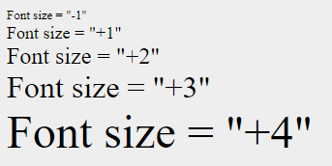
Font Tag with Size
<body>
<font size = "-1">Font size = "-1"</font><br />
<font size = "+1">Font size = "+1"</font><br />
<font size = "+2">Font size = "+2"</font><br />
<font size = "+3">Font size = "+3"</font><br />
<font size = "+4">Font size = "+4"</font>
</body>

Slide 3
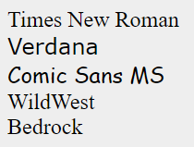
Font with Face
<body>
<font face = "Times New Roman" size = "5">Times New Roman</font><br />
<font face = "Verdana" size = "5">Verdana</font><br />
<font face = "Comic sans MS" size =" 5">Comic Sans MS</font><br />
<font face = "WildWest" size = "5">WildWest</font><br />
<font face = "Bedrock" size = "5">Bedrock</font><br />
</body>

Slide 4

Font Tag with Color
<body>
<font color = "#FF00FF">This text is in pink</font><br />
<font color = "red">This text is red</font>
</body>

Slide 5
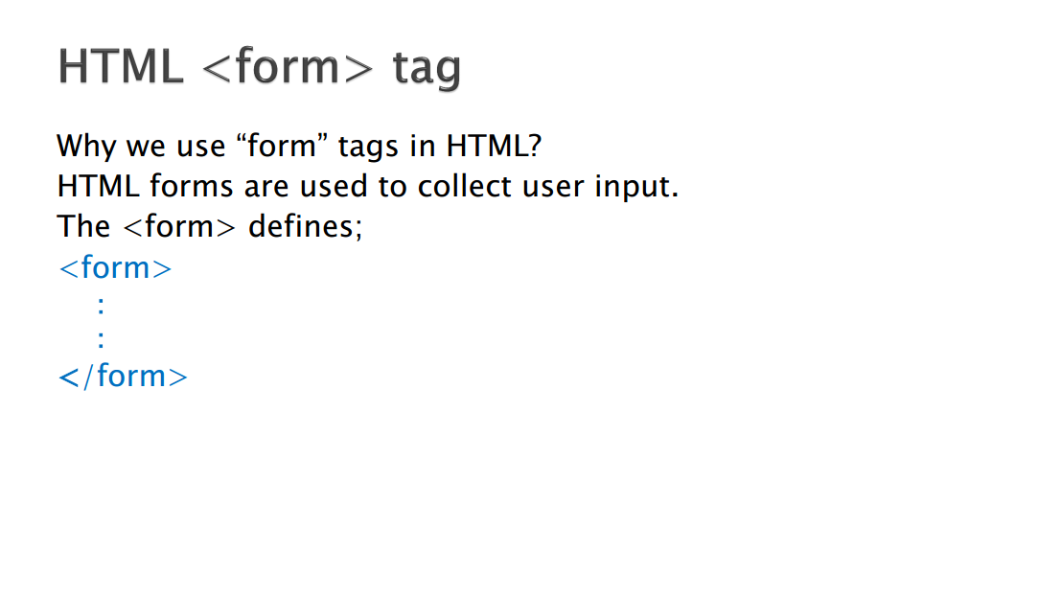

Slide 6
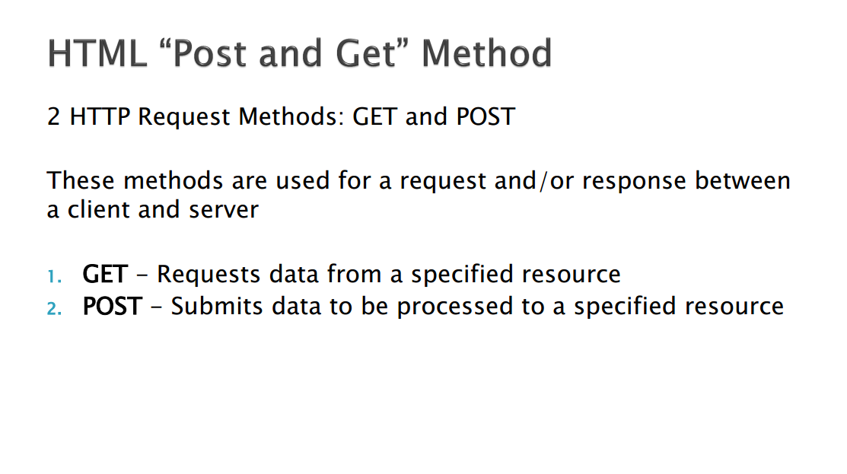

Slide 7
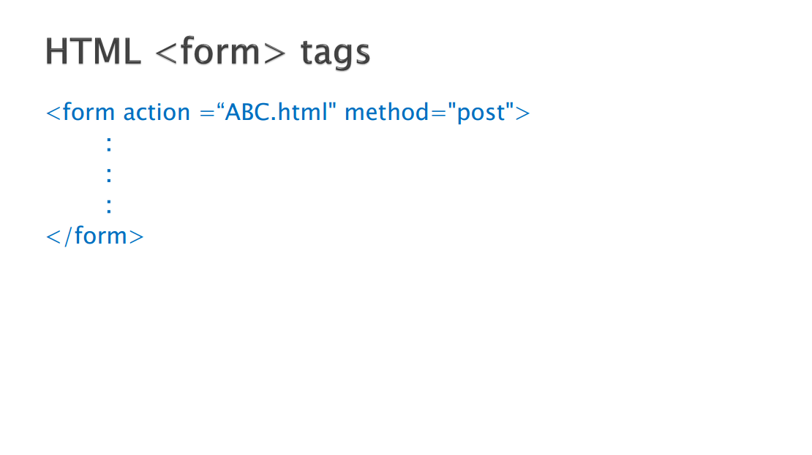

Slide 8


Slide 9
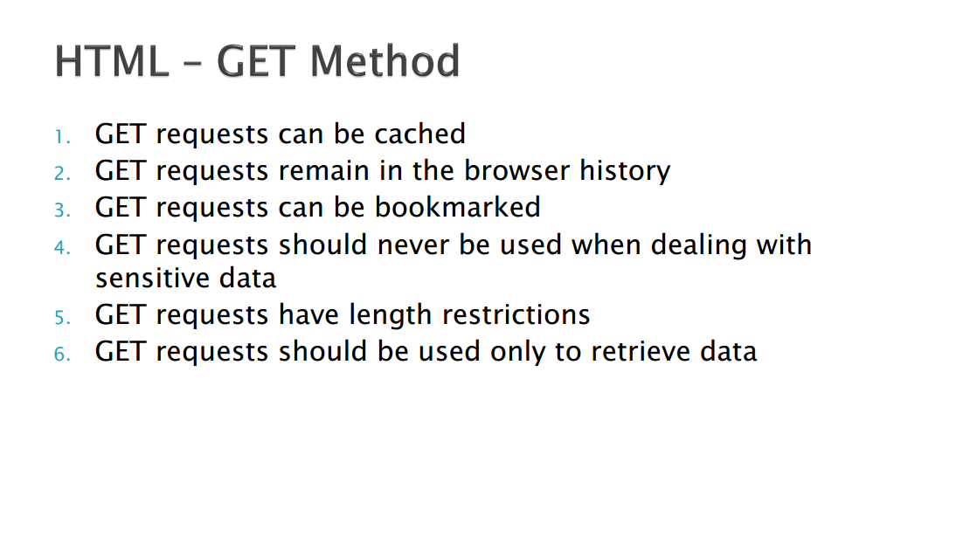

Slide 10
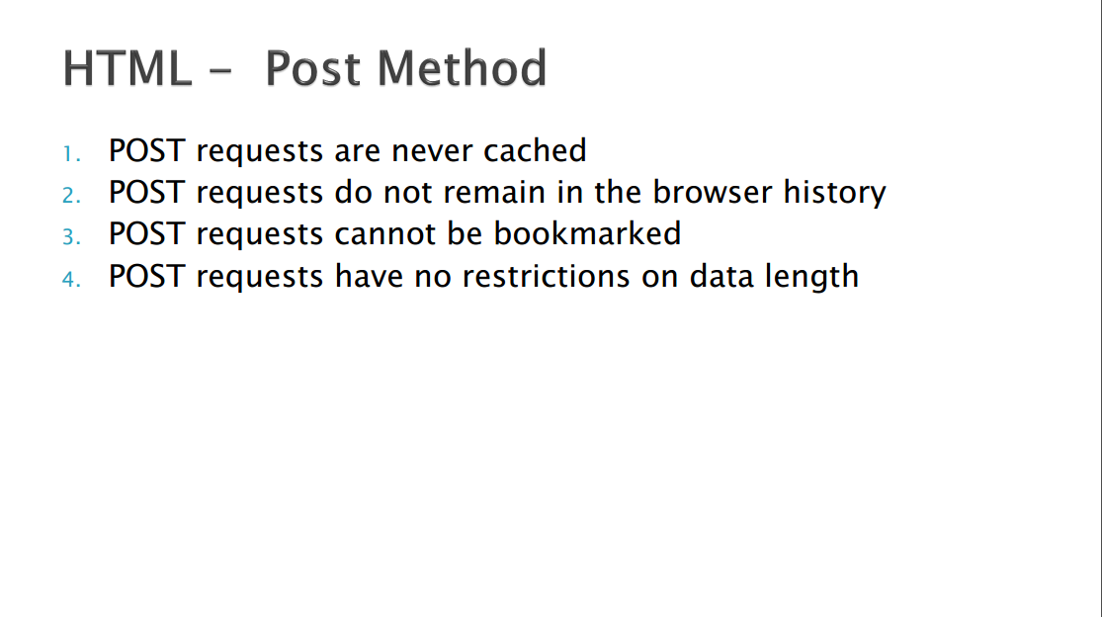

Slide 11
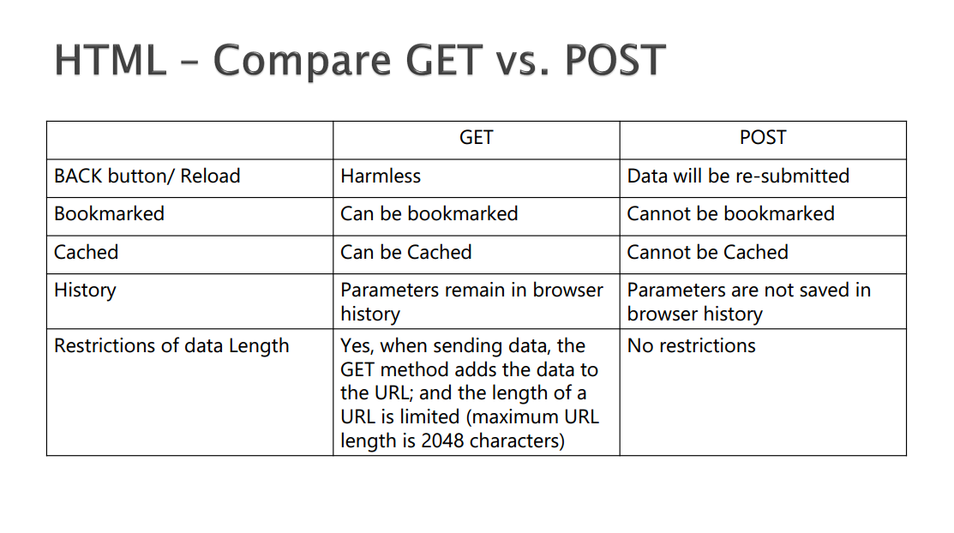

Slide 12
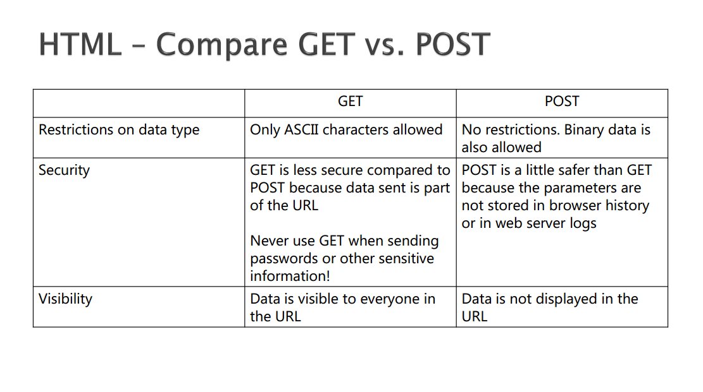

Slide 13
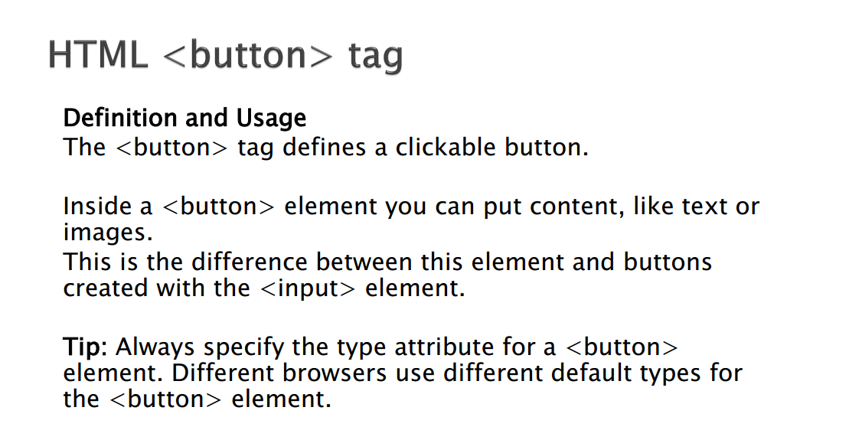

Slide 14
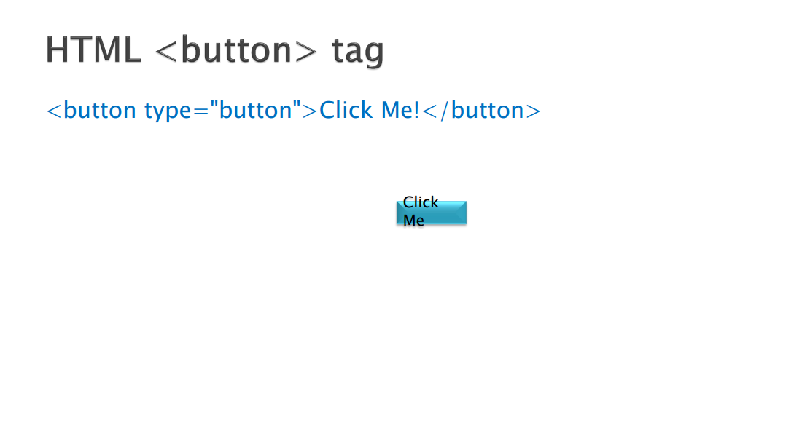

Slide 15
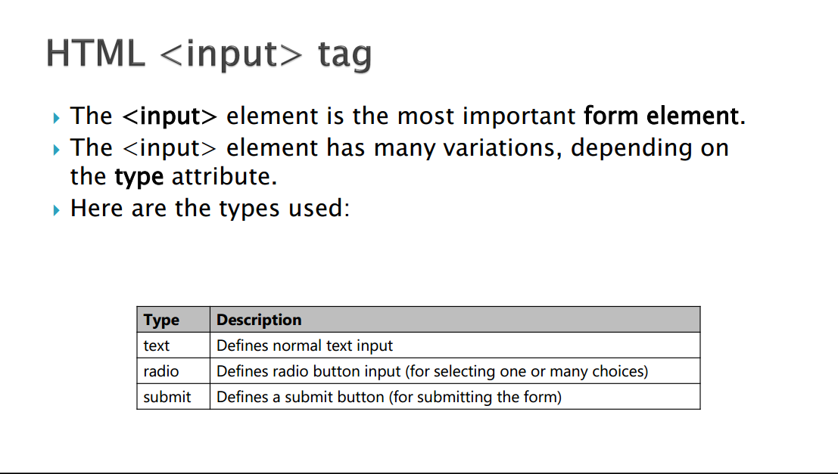

Slide 16
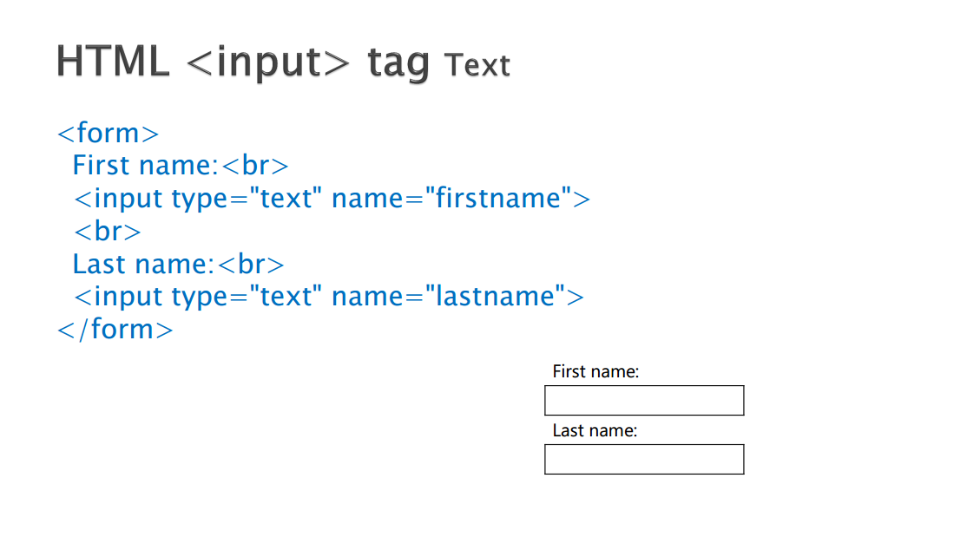

Slide 17
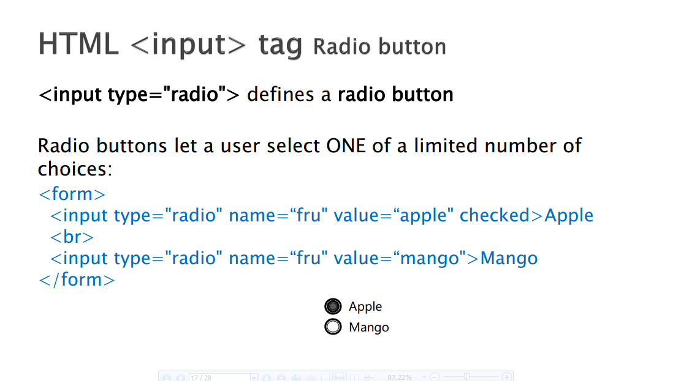

Slide 18
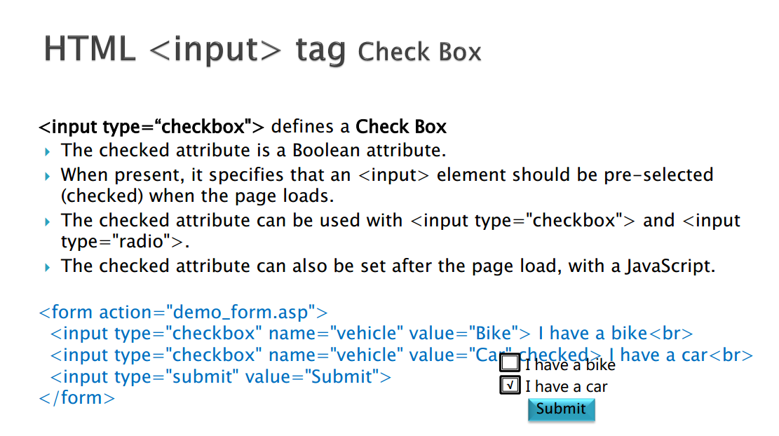

Slide 19
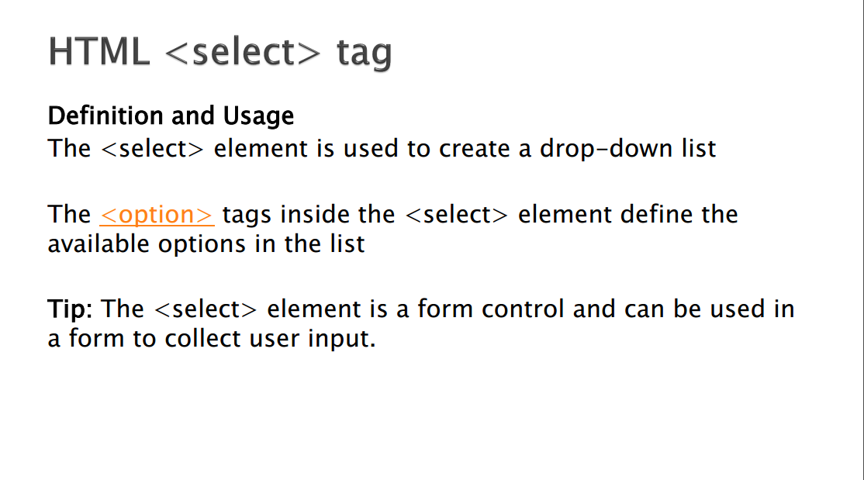

Slide 20
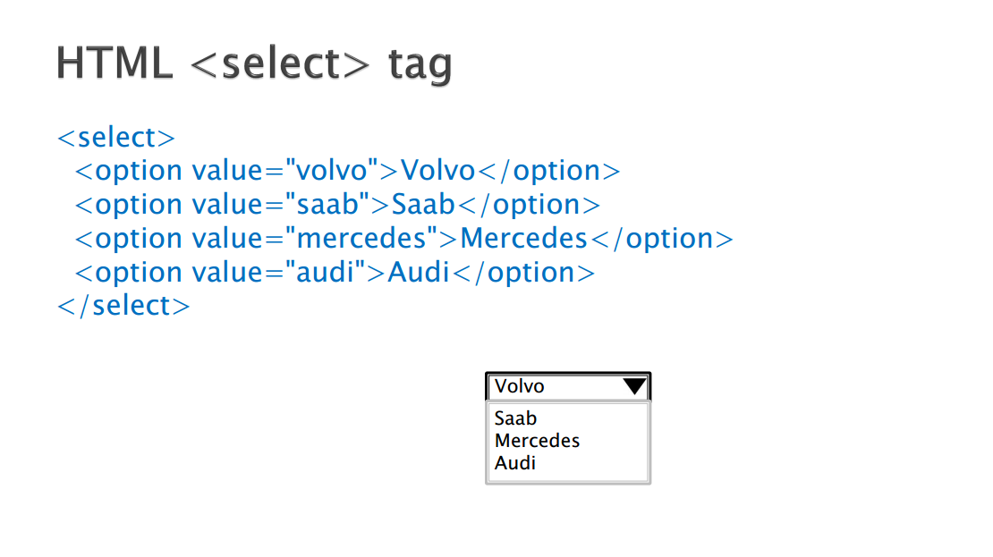

Slide 21
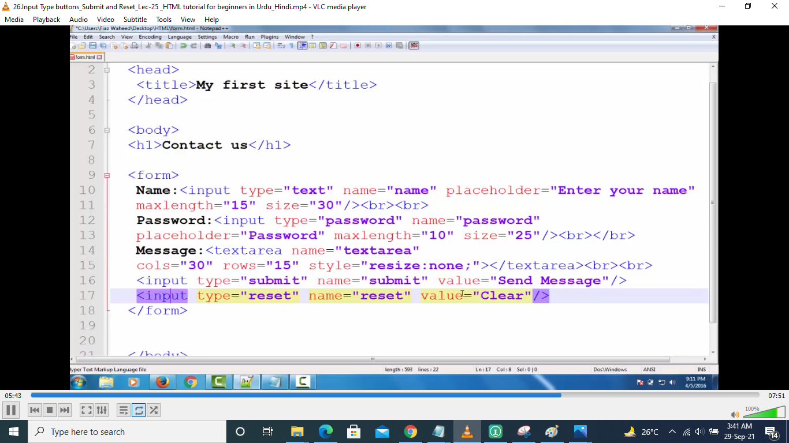

Slide 22
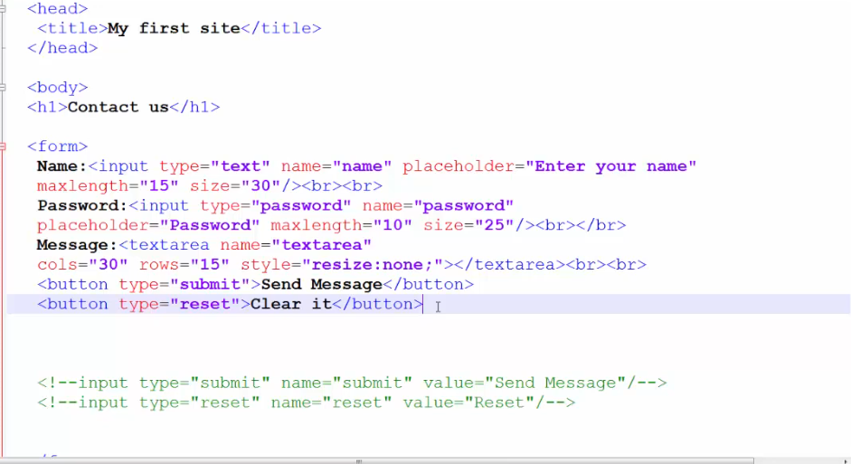

Slide 23
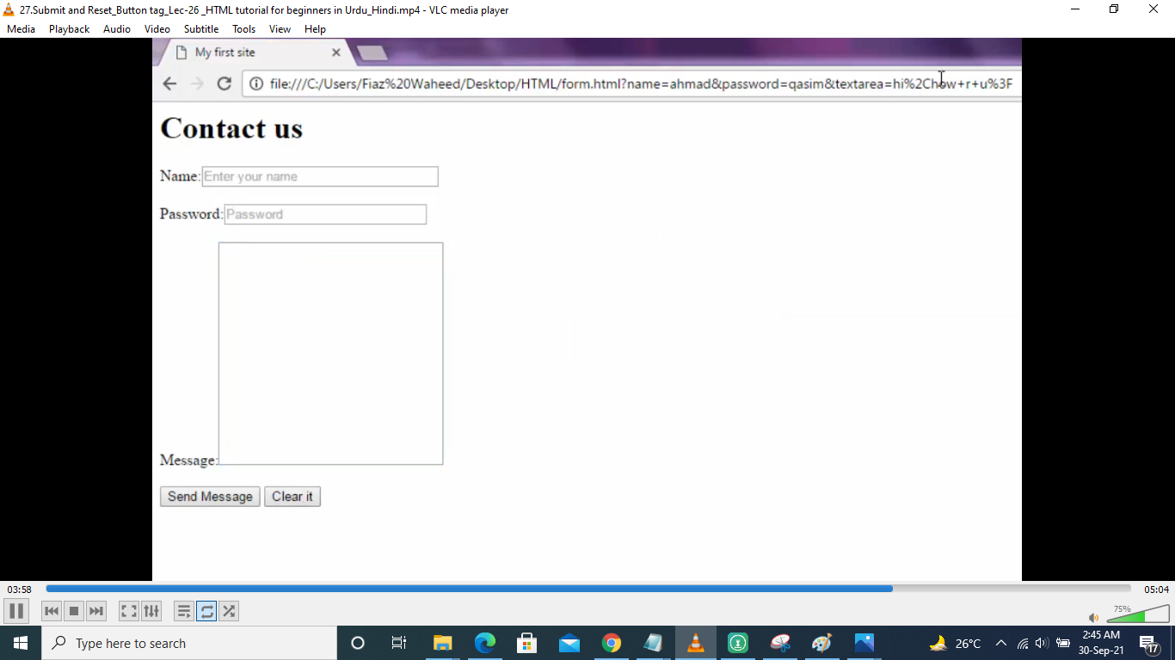

Slide 24
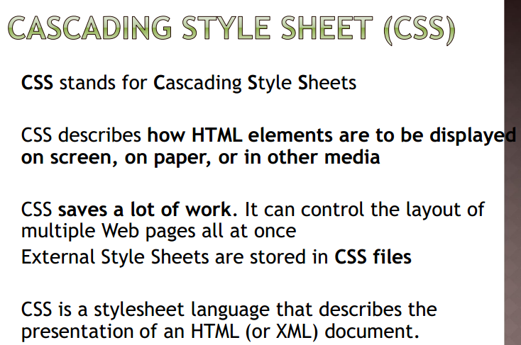

Slide 25
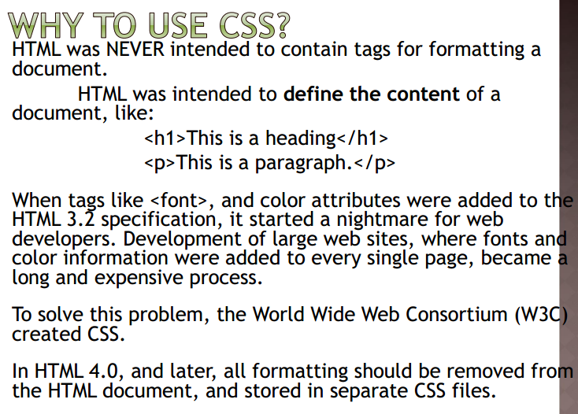

Slide 26
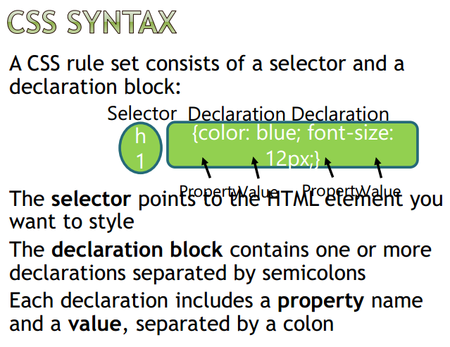

Slide 27
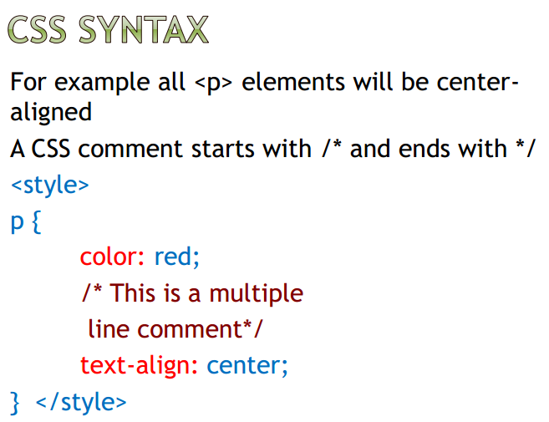

Slide 28
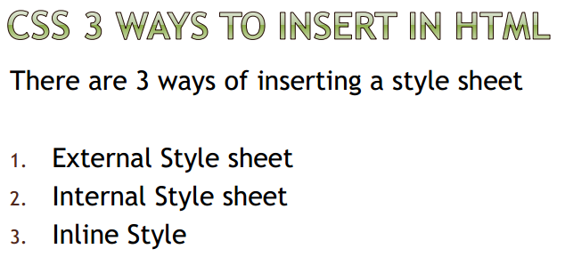

Slide 29
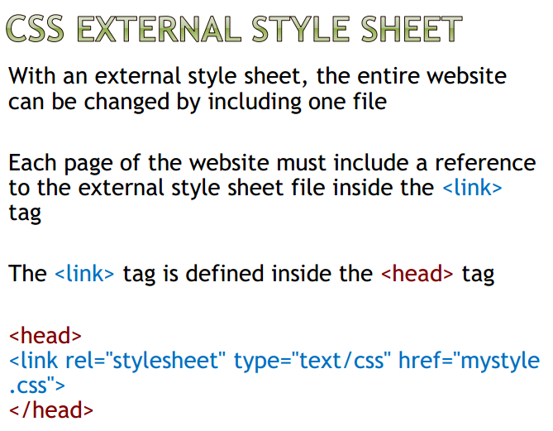

Slide 30
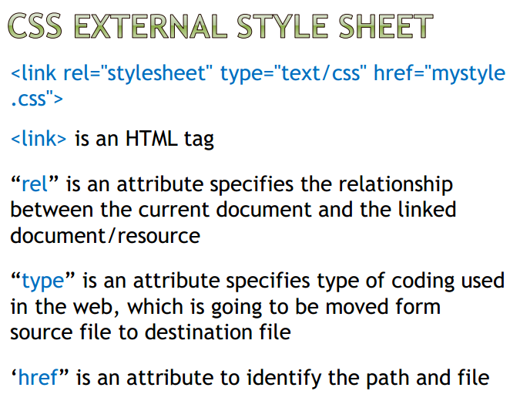

Slide 31
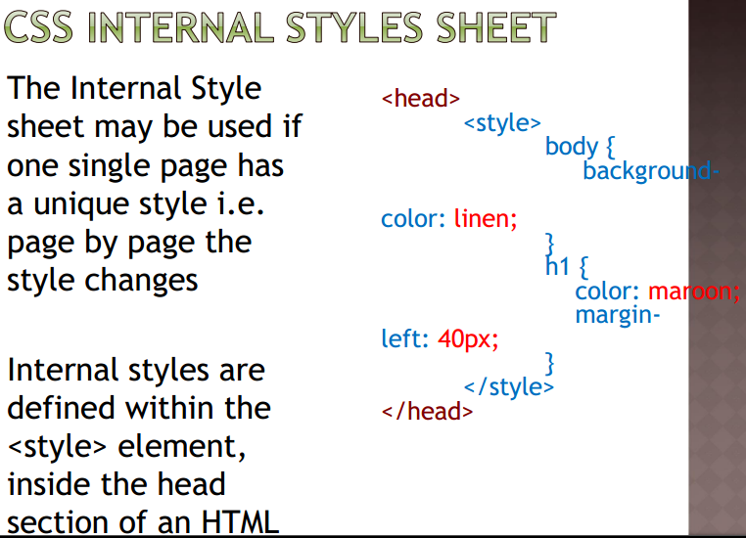

Slide 32
